Slide 1
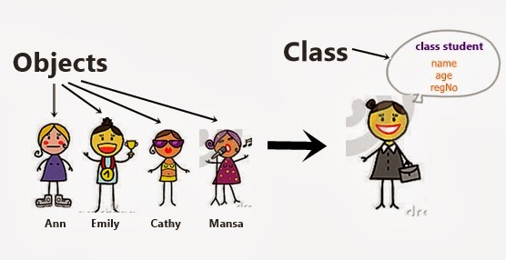
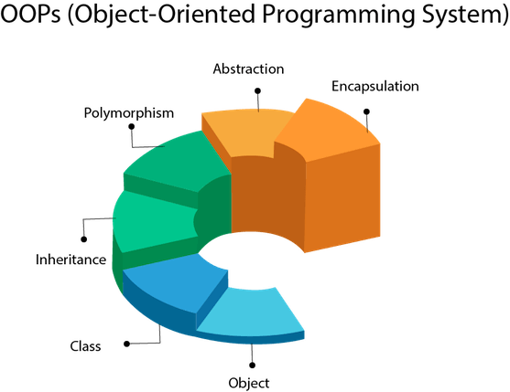
JAVA
Notes:
https://www.softwaretestingmaterial.com/selenium-interview-questions/
https://dzone.com/articles/10-oops-concepts-in-java
http://www.javaguides.net/2018/08/coupling-in-java-with-example.html

Slide 2
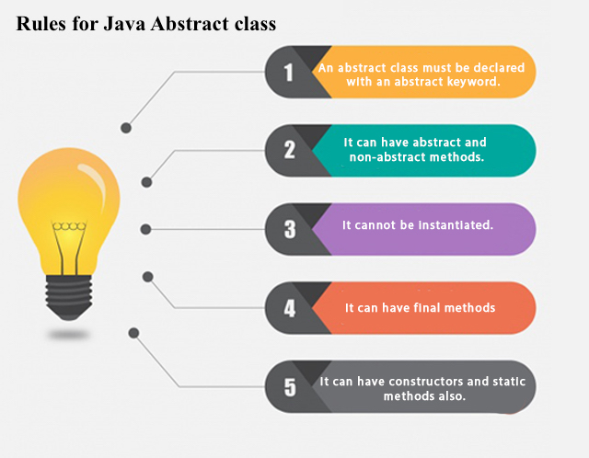
JAVA CLASS
Notes:
https://www.softwaretestingmaterial.com/selenium-interview-questions/

Slide 3
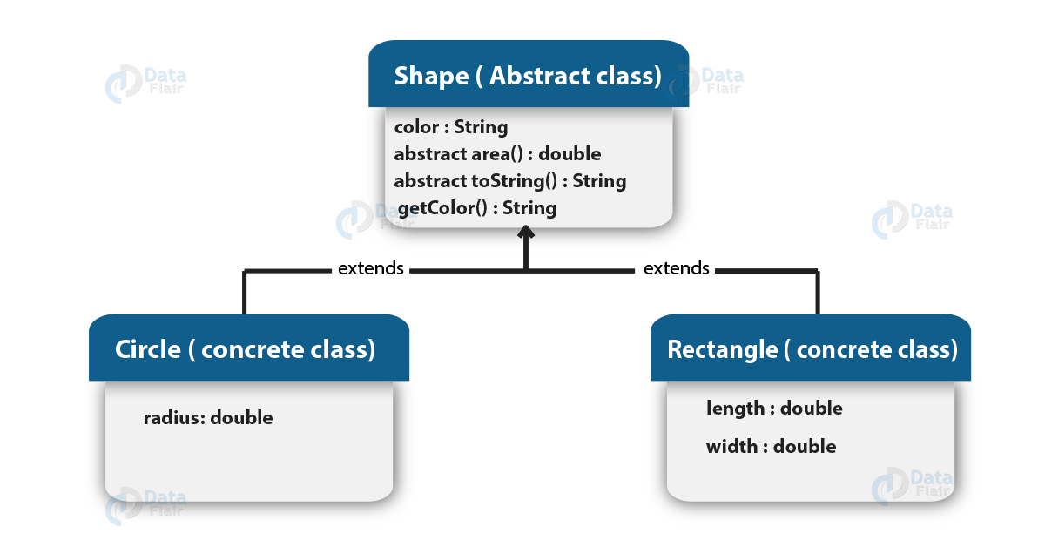
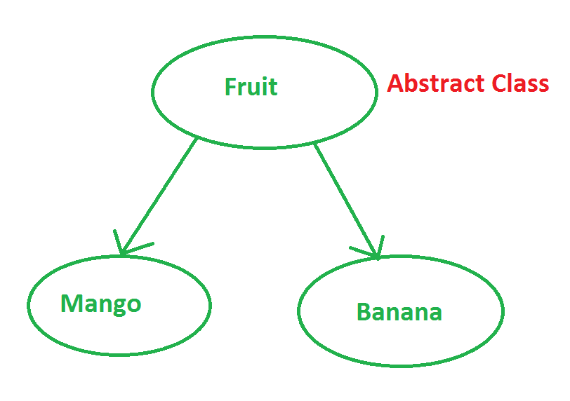
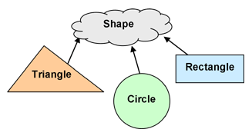
Abstraction
Abstraction means using simple things to represent complexity.

Slide 4
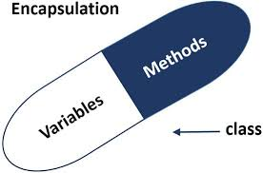
Encapsulation
This is the practice of keeping fields within a class private, then providing access to them via public methods

Slide 5
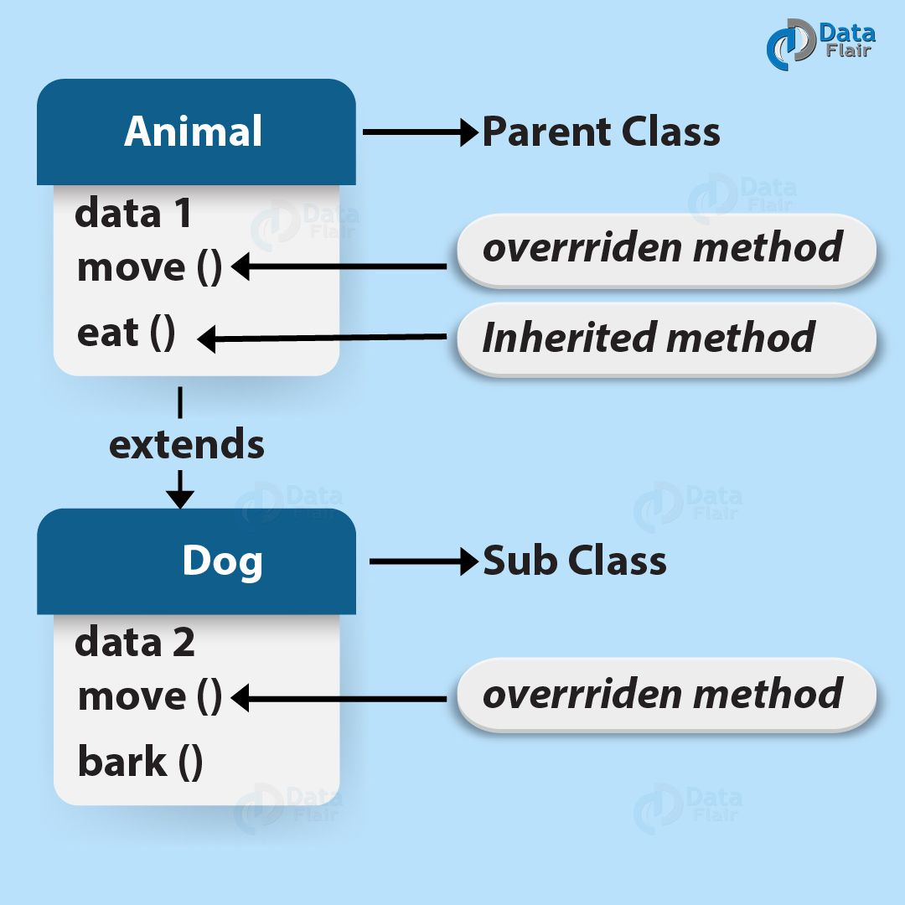
Inheritance
It lets programmers create new classes that share some of the attributes of existing classes.

Slide 6
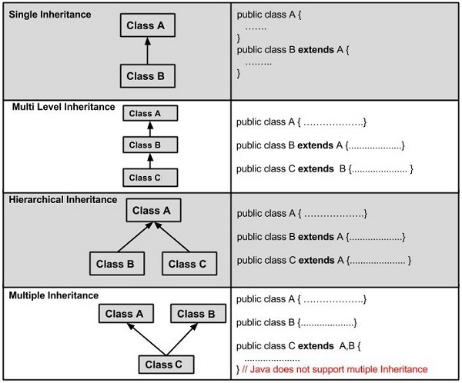
Inheritance
It lets programmers create new classes that share some of the attributes of existing classes.

Slide 7
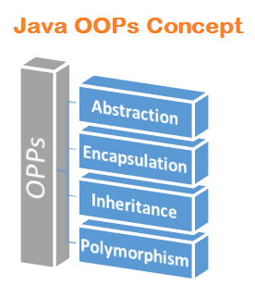
Polymorphism
This Java OOP concept lets programmers use the same word to mean different things in different contexts.
Notes:
http://www.javaguides.net/2018/08/polymorphism-in-java-with-example.html

Slide 8
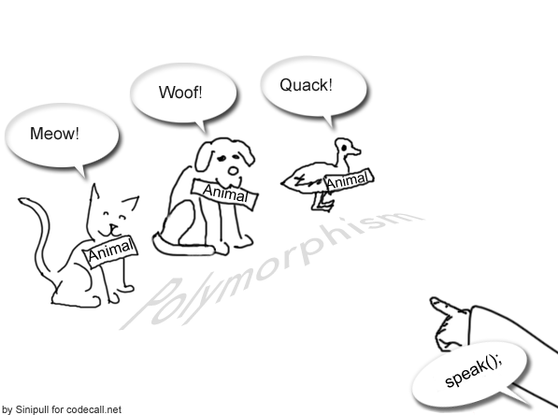
Polymorphism
Method overloading Virtual function
Operator overloading method overriding
Static or Compile Time
Dynamic or Run Time

Slide 9
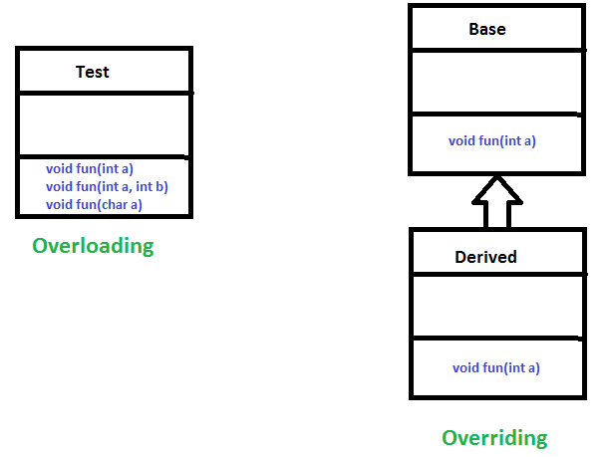
method overloading
a single method name might work in different ways depending on what arguments are passed to it.

Slide 10
method overriding
the child class can use the OOP polymorphism concept to override a method of its parent class.

Slide 11
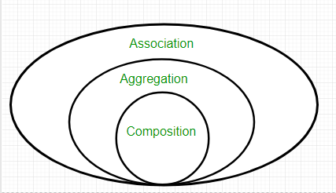
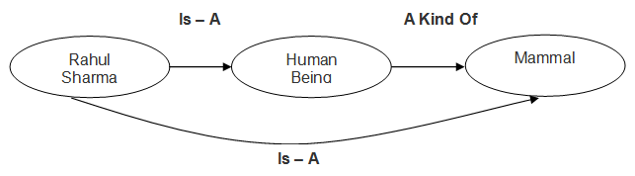
relationship
Notes:
https://www.slideshare.net/AdilAslam4/class-diagram-in-uml

Slide 12
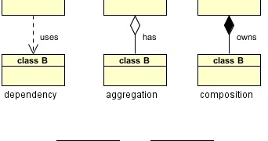
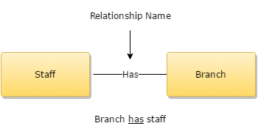
relationship

Slide 13
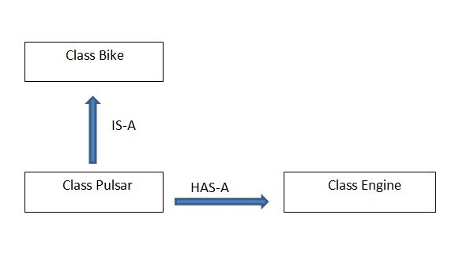
relationship

Slide 14
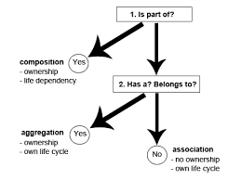
relationship

Slide 15
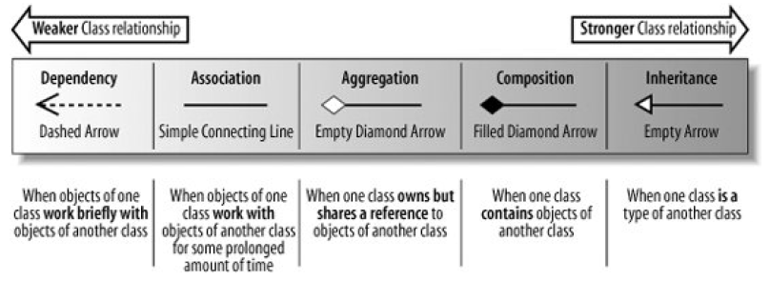
relationship

Slide 16
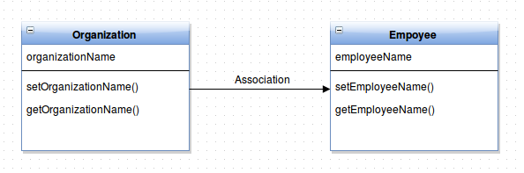
Relationship: Association

Slide 17
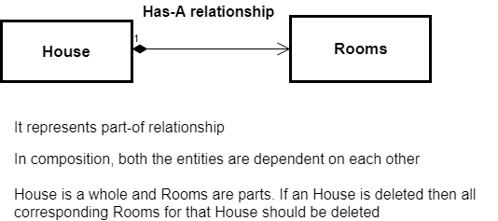
Relationship: Composition

Slide 18
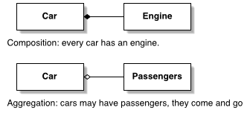
Relationship: aggregation

Slide 19
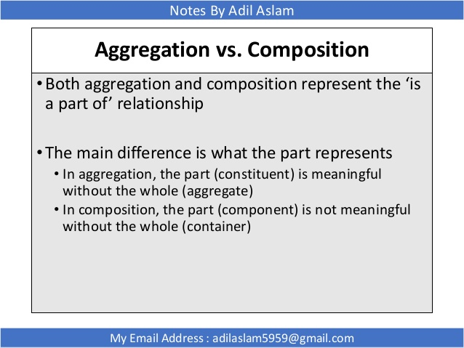
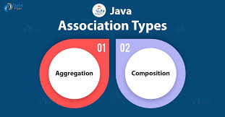
Relationship: aggregation Vs Composition

Slide 20
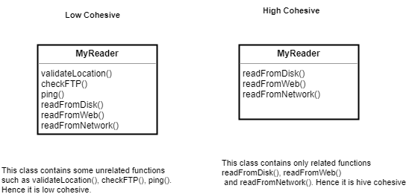
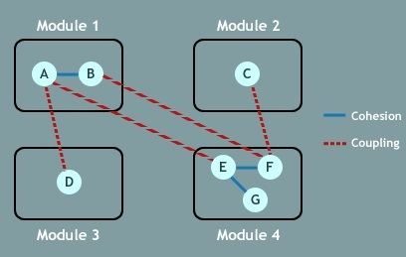
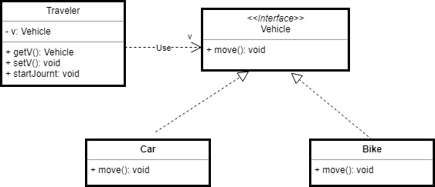
Relationship: coupling and cohesion
Notes:
Coupling
Intent
Coupling refers to the degree in which one class knows about another class. If one class uses another class, that is coupling. This includes low dependencies between “artifacts” (classes, modules, components).There shouldn’t be too much of a dependency between the modules; even if there is a dependency, it should be via the interfaces and should be minimal.
Key Points
While creating a complex application in Java, the logic of one class will call the logic of another class to provide the same service to the clients.
If one class is calling another class logic, then it is called collaboration.
When one class is collaborating with another class, then there exists a tight-coupling between the two classes.
If one class wants to call the logic of a second class, then the first class needs an object of a second class. It means the first class creates an object of a second class.
Cohesion
Intent
The term cohesion is used to indicate the degree in which a class has a single, well-focused responsibility. Cohesion is a measure of how the methods of a class or a module are meaningfully and strongly related and how focused they are in providing a well-defined purpose to the system.
Explanation
In object-oriented design, cohesion refers all about how a single class is designed. Cohesion is the Object Oriented principle most closely associated with making sure that a class is designed with a single, well-focused purpose.
The more focused a class is, the cohesiveness of that class is more.
The advantages of high cohesion are that such classes are much easier to maintain (and less frequently changed) than classes with low cohesion. Another benefit of high cohesion is that classes with a well-focused purpose tend to be more reusable than other classes.

Slide 21
Relationship: coupling and cohesion
Notes:
In this example, the purpose of MyReader class is to read the resource. But it contains some unrelated functions such as validateLocation(), checkFTP(), ping(). Hence it is low cohesive.
A class is identified as a low cohesive class when it contains many unrelated functions within it. And that what we need to avoid because big classes with unrelated functions hamper their maintaining. Always make your class small and with precise purpose and highly related functions.
http://www.javaguides.net/2018/08/cohesion-in-java-with-example.html

Slide 22
Relationship: coupling and cohesion
Notes:
This is an example of loose coupling. In this class, Traveler class is not tightly coupled with Car or Bike implementation. Instead by applying dependency injection mechanism, the loose coupling implementation is achieved to allow start journey with any class which has implemented Vehicle interface.
http://www.javaguides.net/2018/08/coupling-in-java-with-example.html

Slide 23
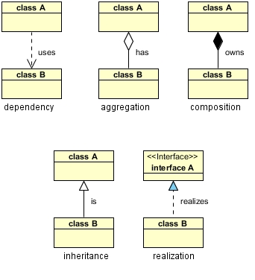
Relationship: UML diagram

Slide 24
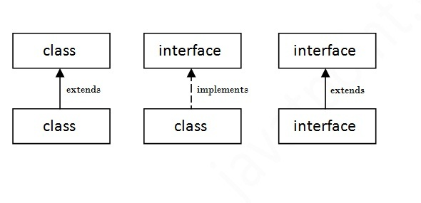
Interface in java

Slide 25
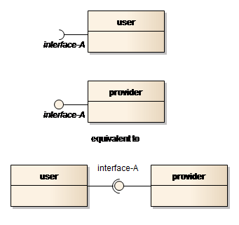
Interface in java

Slide 26
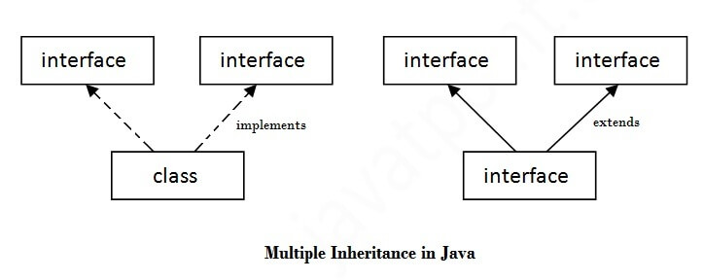
Interface in java

Slide 27
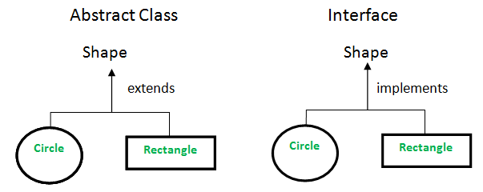
Interface in java

Slide 28
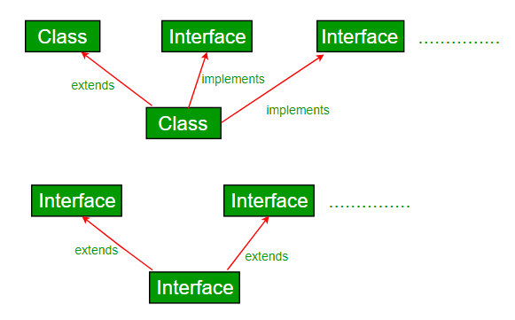
Interface in java

Slide 29
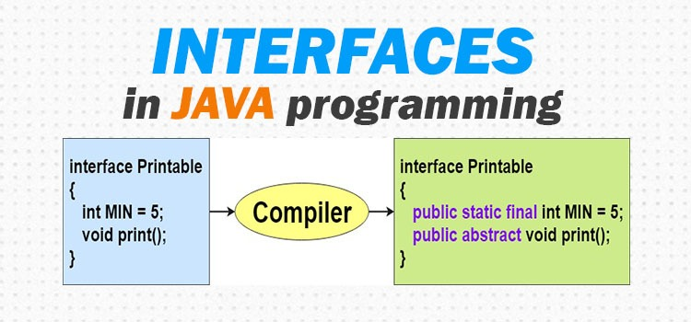
Interface in java

